Slide 1
2019
Yr 5/6 Quiz
Round 1

Slide 2
Session 1: Estimation
There will be 5 questions, each worth 1 point
After each question, there will be a time interval during
which the teams may confer among themselves and write
the answer on the paper provided
At the end of the allotted time, a gong will sound and each
team must hold up its answer for the audience to see
The compère will then indicate to the scorer which teams
have the correct answer
Calculators are NOT permitted
Pencils, rulers, scissors, and so on ARE permitted
Units must be given when required(half point penalty)

Slide 3
Session 1: Estimation
Question 1
Face down on the sheet of paper on your table is a large ochre (yellow) square and three smaller blue squares labelled A, B, and C. Please carefully cut out the three blue squares A, B and C.
When everyone is ready click to see the question ….

Slide 4
Session 1: Estimation
Question 1
Which of the blue squares A, B, or C has an area of approximately half that of the large ochre (yellow) square? Write the letter of the square you choose on the paper and hold up your answer.
You have 30 seconds… click to start the timer

Slide 5
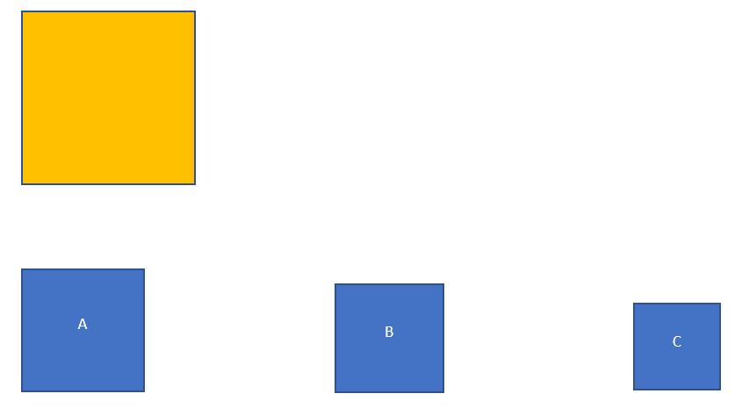
Session 1: Estimation
Time’s up!
Hold up your answer…
30
29
28
27
26
25
24
23
22
21
20
19
18
17
16
15
14
13
12
11
10
9
8
7
6
5
4
3
2
1

Slide 6
Answer: ‘A’ or ‘square A’
(The area of the blue square A is closest to half the area of the large ochre square)

Slide 7
Session 1: Estimation
Question 2
Estimate how long it takes Big Ben (London) to ring out the ‘Westminster Chimes” …..(please note that watches and clocks must be covered, and the sound clip will be played twice)
Once the sound clip finishes the second time, the timer will start and you will have only 15 seconds to discuss and write down your answer
Click here to start the sound clip the first time

Slide 8
Session 1: Estimation
Question 2
Watches and clocks must be covered ….
Time’s up!
Hold up your answer…
The timer will start automatically after the clip is played the second time. You will have 15 seconds only to discuss and write down your answer.
Click here to play the clip a second time.
12
9
14
8
10
7
3
11
6
1
5
13
15
2
4

Slide 9
We timed the clip at nearly 20 seconds
Accept 17 – 23 seconds

Slide 10
Session 1: Estimation
Question 3
You should have a tennis ball on your table and some buckets are being passed round for you to inspect. Once everyone has had an opportunity to inspect the bucket and tennis balls, click to see the question.

Slide 11
Question 3
Tennis balls are dropped into a bucket until it is full to overflowing. Estimate how much empty space is in the bucket between the balls. Answer as a fraction of the volume of the bucket by choosing the best answer from the options provided.
a) $\frac{1}{2}$ b) $\frac{1}{3}$ c) $\frac{1}{4}$
You have 30 seconds to answer.
Click to start the timer ….
Time’s up!
Hold up your answer…
30
29
28
27
26
25
24
23
22
21
20
19
18
17
16
15
14
13
12
11
10
9
8
7
6
5
4
3
2
1

Slide 12
Session 1: Estimation
The fraction of empty space left in the bucket after it’s filled with tennis balls is closest to ..
one half
one third ✓
one quarter
(random spherical packing calculations predict about 36% of free space)

Slide 13
Session 1: Estimation
Question 4
You may not want to stand on this bed of nails let alone lie on it …..
Estimate the number of nails in this fakir’s ‘bed of nails’ – choose the answer you think is best …
Click to see the ‘bed of nails’ and alternative answers then click again to start the timer ….
… you have 30 seconds to answer

Slide 14
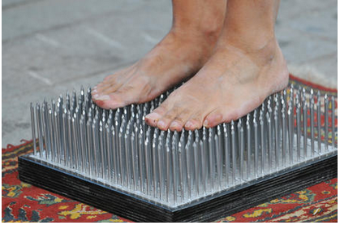
Time’s up!
Hold up your answer…
100 nails
300 nails
500 nails
700 nails
30
29
28
27
26
25
24
23
22
21
20
19
18
17
16
15
14
13
12
11
10
9
8
7
6
5
4
3
2
1

Slide 15
Session 1: Estimation
Answer: we estimate about 530 nails would be needed so the best answer is ‘C’ or 500 nails

Slide 16
Session 1: Estimation
Question 5
A label on a lift reads ‘safe working load 1050kg’. In Australia, the average weight of an adult is often taken as 85kg.
What is the maximum number of ‘average’ adults that could safely fit into this lift at one time?
You have 30 seconds; click to start the timer ……
Time’s up!
Hold up your answer…
30
29
28
27
26
25
24
23
22
21
20
19
18
17
16
15
14
13
12
11
10
9
8
7
6
5
4
3
2
1

Slide 17
Session 1: Estimation
Answer: up to 12 ‘average’ adults should be able to use the lift in safety

Slide 18
Session 1: Estimation
That concludes
Session 1: Estimation

Slide 19
Session 2: Speed
The rules of engagement for this part of the quiz are …..

Slide 20
Questions will be read once in a normal clearly audible voice at a normal speaking speed. Questions are read out, and not explained.
The 2-minute time allowance starts after the first question has been read out.
All correct answers are worth one mark. Any member of the team may answer a question but should confer and the captain will call out the answer
Once an answer has been given, subsequent changes are not permitted. If different answers are called out the captain must choose which is the answer – a new or different answer cannot be substituted.
If units are required and omitted, ½ mark will be deducted; apart from this exception, no part marks are allowed
Captains may ‘pass’ on a question, or ask for it to be repeated. If a question is ‘pass’, it will be asked again after all other questions have been attempted if there is still time remaining in the overall 2 minutes.
When “Time!” is called, the session has finished. No answers can be accepted after “Time!” is called. An answers given before or on the ‘Time!’ call will be marked and included in the total.

Slide 21
Session 2: Speed
Team 1
The teams will now leave the room to complete their session. The questions and answers to this session will be displayed after all teams have completed the questions.
Time’s up!
1:30
1:29
1:28
1:27
1:26
1:25
1:24
1:23
1:22
1:21
1:20
1:19
1:18
1:17
1:16
1:15
1:14
1:13
1:11
1:10
1:09
1:12
1:08
1:07
1:06
1:05
1:04
1:03
1:02
1:01
2:00
1:59
1:58
1:57
1:56
1:55
1:54
1:53
1:52
1:51
1:50
1:49
1:48
1:47
1:46
1:45
1:43
1:41
1:44
1:40
1:39
1:38
1:37
1:36
1:35
1:34
1:42
1:33
1:32
1:31
1:00
59
58
57
56
55
54
53
52
51
50
49
48
47
46
45
44
43
42
41
39
38
37
35
36
34
33
32
40
31
30
29
28
27
26
25
24
23
22
21
20
19
18
17
16
15
14
13
12
11
10
9
8
7
6
5
4
3
2
1
Click to start the timer.
You have 2 minutes…

Slide 22
Session 2: Speed
After all the teams have completed the questions and returned to the room we’ll show the questions and answers ….
Warning – the next slide contains the questions and answers for this section – do not ‘click’ on until all teams have competed their sessions.

Slide 23
Answers:
 | Questions | Answer
1 | What is the sum of 1019 and 91? | 1110
2 | What is nine divided by nine-tenths? | 10
3 | If two angles in a triangle are 50° and 60°, what is the third angle? | 70°
4 | How many metres in ‘three and a quarter kilometres’ | 3250
5 | What is the smallest total number of 20c and 50c coins I’ll need to buy a box of chocolates on sale for $7.60? | 17
6 | What is ‘six eighteenths’ as a fraction in its simple form? | 1/3
7 | What is the difference between negative six and negative nine? | 3
8 | A bag of chips costs $1.55. How much change do I get if I buy two bags of chips with a $10 note? | $6.90
9 | What is a half of zero-point-five? | 0.25
10 | How many minutes from a quarter to two in the afternoon until half past three in the afternoon on the same day? | 105

Slide 24
Session 2: Speed
That concludes
Session 2: Speed

Slide 25
Session 3: Written Problems
Teams are now split up so that students from the same
teams or school are not sitting next to each other. Each
student has their own question and answer sheet
All contestants will be given the same 4 questions, and must
work on them individually
Only the answer written in the space provided will be marked.
Contestants should use the ‘working paper’ available but only
the answers on the official sheet will be marked
Calculators, rulers and so on ARE permitted in this session.
Each question is worth one point so a team may achieve a
maximum of 12 points in this session
There is a time limit of 15 minutes
For the benefit of the audience, the questions will be displayed
on the screen
Click to see the questions and start the timer……

Slide 26
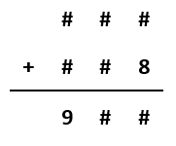
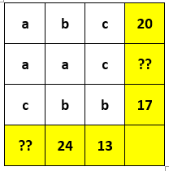
The length of a rectangle is four times its width. If the area of the rectangle is 100m² what is the length of the rectangle?
Using all the digits from 1 to 9 with no repeats find a solution for the addition sum shown (two numbers have been entered to help you get started ….)
Here is a number grid. The letters a, b, and c stand for three different numbers. The sums of the numbers in each row are shown at the end the row and the sums of each column at the bottom of each column. What is the missing total marked ‘??’ in the grid?
At the school sports day there were 100 children on a playing field. 25% of them were boys. After some boys from another school joined the children on the field, the percentage of children on the field who were boys increased to 40%. How many boys came onto the field from the other school?
Time’s up!
2 min remaining
7 mins remaining
11 mins remaining
6 mins remaining
3 mins remaining
5 mins remaining
4 mins remaining
9 mins remaining
8mins remaining
12 mins remaining
10 mins remaining
14 mins remaining
15 mins remaining
30
29
28
27
26
25
24
23
22
21
20
19
18
17
16
15
14
13
12
11
10
9
8
7
6
5
4
13 mins remaining
1
3
2

Slide 27
Answers:
20m long
One solution is
The missing sum is 23 (where a=10, b=7, and c = 3)
25 boys joined from the other school

Slide 28
That concludes
Session 3: Written Problems

Slide 29
Session 4: Individual Short Answer
Three questions will be asked, one at a time.
For each team, the first question is for a team member from
year 5.
Assistance from other team members is not allowed.
Calculators are permitted.
There will be a 20 second interval to write the
answer down and hold it up for the audience to see.
The judges will then indicate to the scorer which
teams have the correct answer.
Each question in this session is worth 2 points so each team
can score a maximum of 6 points in this session.
These steps will be repeated with the second question being
asked of the remaining team member (not captain) and the
third question of the captain.

Slide 30
Session 4: Individual Short Answer
Will a Year 5 member of each team put up your hand, please?
This first question is for you.
Click to see and read the first question and click again to start the timer.
You will have 20 seconds after the timer starts…

Slide 31
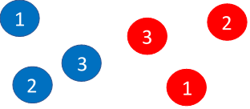
Session 4: Individual Short Answer
Question 1
Ally picks a red ball and a blue ball at random.
If she multiplies the numbers on the two balls together, what are the possible odd number answers she could get?
…. click to start the timer
Time’s up!
Hold up your answer…
20
19
18
17
16
15
14
13
12
11
10
9
8
7
6
5
4
3
2
1

Slide 32
Session 4: Individual Short Answer
Answer: The possible odd number results are 1, 3, and 9
(the multiples giving odd numbers are 1×1, 1×3 (or 3×1), 3×3)

Slide 33
Session 4: Individual Short Answer
Will the other member of the team (not the captain) put up your hand please?
The next question is for you. Click to see and read the question - then click again to start the timer.
You have 20 seconds…

Slide 34
Session 4: Individual Short Answer
Question 2
A definition of a ‘free range chicken (or egg)’ farm is that there should be no more than 10,000 hens per hectare of outdoor space. How many hens would you expect to find on 1 square metre of outdoor space?
…. click to start the timer
Time’s up!
Hold up your answer…
20
19
18
17
16
15
14
13
12
11
10
9
8
7
6
5
4
3
2
1

Slide 35
Session 4: Individual Short Answer
Answer: 1 hen per square metre (… since there are 100 x 100 or 10,000 square metres in a hectare)

Slide 36
Session 4: Individual Short Answer
Will the team captain of each team put up your hand please?
The next question is for you.
Click to see the question and click again to start the timer.
You have 20 seconds…

Slide 37
Session 4: Individual Short Answer
Question 3
The internal angle sum of a 3-sided polygon (triangle) is 180° and of a 4-sided polygon (quadrilateral) is 360°.
What is the internal angle sum of a 6-sided polygon (hexagon)?
…. click to start the timer
Time’s up!
Hold up your answer…
20
19
18
17
16
15
14
13
12
11
10
9
8
7
6
5
4
3
2
1

Slide 38
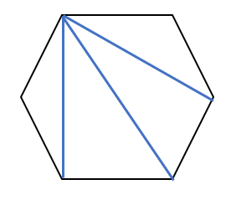
Session 4: Individual Short Answer
Answer: 720° ‘degrees’ (unit required – ½ pt penalty)
- you can think of a hexagon as containing 4 triangles, each having and internal angle sum of 180° (4 × 180 = 720)

Slide 39
Session 4: Individual Short Answer
That concludes
Session 4:
Individual Short Answer

Slide 40
Session 5:
General Knowledge
There will be 5 questions, each worth one point.
The compère will ask a question and there will be a 20 second
interval during which a team may confer among itself and
write the answer on one of the sheets of paper provided. Some
questions allocate bonus time for discussion
At the gong, each team must hold up their answer for the
audience to see.
The judges will then indicate to the scorer which schools have
the correct answer.
Calculators are permitted.

Slide 41
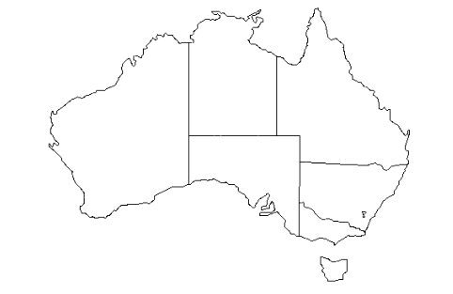
Session 5: General Knowledge & Skill
Question 1
What is the minimum number of colours that you would have to use to colour in a map of the States and Territories in Australia so that no two States or Territories next to each other or touching at corners had the same colour? There’s a blank map on the desk – please turn this over when the timer starts …
… click to start the timer
Click to see the first question
and click again to start the timer.
You have 20 seconds…
Time’s up!
Hold up your answer…
1
20
19
18
17
16
15
14
13
12
11
10
9
8
7
6
5
4
3
2

Slide 42
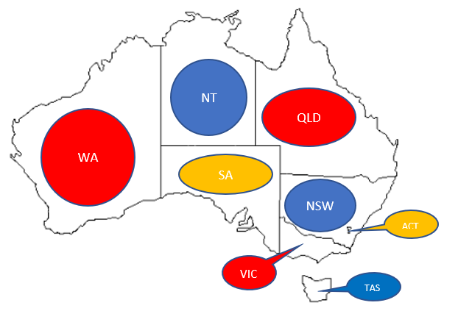
Session 5: General Knowledge & Skill
Answer: Since Australia has a simple layout with lots of straight line borders only three colours are needed…
… a more complex example with four colours is on the next slide

Slide 43
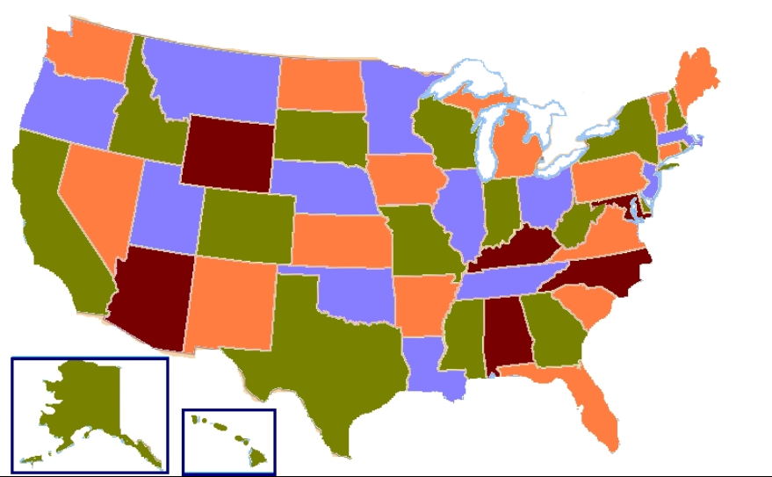
Session 5: General Knowledge & Skill
The four-colour map theorem states that any ‘map’ can be colour coded using no more than four colours without adjacent areas being in the same colour ….

Slide 44
Session 5: General Knowledge & Skill
Question 2
What are the names of the two geometric shapes used to make a modern soccer ball (imagine the ball is opened and flattened out) ….
Time’s up!
Hold up your answer…
Click to see the second question
and click again to start the timer.
You have 20 seconds…
20
19
18
17
16
15
14
13
12
11
10
9
8
7
6
5
4
3
2
1

Slide 45
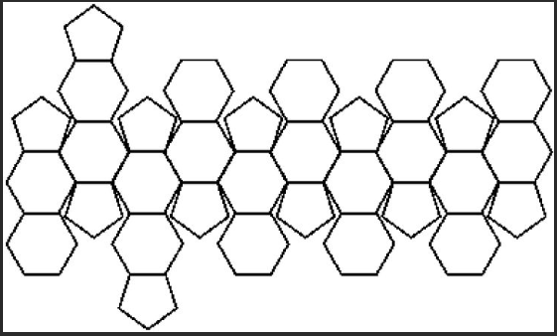
Session 5: General Knowledge & Skill
Answer: hexagon and pentagon (and here’s a net of a typical ball …)

Slide 46
Session 5: General Knowledge & Skill
Question 3
How many leap years are there between 2019 and 2039?
…. click to start the timer
Click to see the third question and to start the timer.
You have 20 seconds…
Time’s up!
Hold up your answer…
20
19
18
17
16
15
14
13
12
11
10
9
8
7
6
5
4
3
2
1

Slide 47
Session 5: General Knowledge & Skill
Answer:
There are five (5) leap years between 2019 and 2039 (2020, 2024, 2028, 2032, 2036)

Slide 48
Session 5: General Knowledge & Skill
Question 4
Imagine a rope being pulled tightly round the world at the Equator. The length of rope needed would be about 40,030km. Imagine now that the rope is lifted up 2m above the Equator all the way round the Earth. Which of the following best represents the total length of the rope now needed?
43,030km
42,030km
41,030km
40,030km
Time’s up!
Hold up your answer…
Click to see the fourth question
and click again to start the timer.
20
19
18
17
16
15
14
13
12
11
10
9
8
7
6
5
4
3
2
1

Slide 49
Session 5: General Knowledge & Skill
Answer (d) 40,030km.
Using the circumference of a circle formula (2πr) with the new radius (radius of Earth + 0.002km) allows us to calculate the required increase in length at about 6.3m – in other words it’s not much different to the original length of rope.

Slide 50
Session 5: General Knowledge & Skill
Question 5
In a stable there are only humans (all with two legs) and horses (all with four legs). In all, there are 16 heads and 52 feet. How many humans and how many horses are in the stable?
I will time10 seconds bonus and then click to start the timer. You will have 20 seconds to answer after the timer starts. Start now..
Click to see the fifth question and click again to start the timer. You will have bonus time to discuss your response and then 20 seconds to complete your answer…
Time’s up!
Hold up your answer…
20
19
18
17
16
15
14
13
12
11
10
9
8
7
6
5
4
3
2
1

Slide 51
Session 5: General Knowledge & Skill
Answer: there would be
6 humans and 10 horses
6 x 2 and 10 x 4 (52 legs and 16 heads)

Slide 52
Session 5: General Knowledge & Skill
That concludes
Session 5: General Knowledge

Slide 53
…and the winner of the 2019 Y5/6 Quiz is ..
… please wait for a few moments while the scorers check the totals. If necessary we will go to the tie-breaker…

Slide 54
TIE BREAKER
There will be one question, worth 1 point.
The first team to write down and hold up the correct
answer will be awarded the point
If there is no winner after two minutes, the judge
will close the quiz, and award the point to the team
which came closest
Teams must keep a record all the answers held up
This is a team question, and calculators are
permitted but not necessary
Any questions? Click to see the question ..

Slide 55
TIE BREAKER
We have just put a sheet of paper, face down,
on your table.
When you are asked, turn the paper over and
count how many squares of all sizes you
can find in the diagram
Are you ready? …..
Go! ….

Slide 56
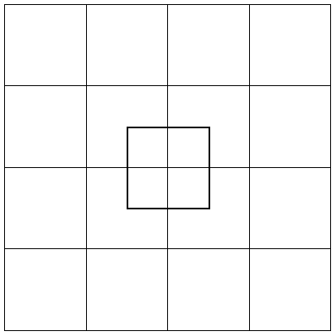
TIE BREAKER
Warning – don’t click on this page until you wish to show the answer …

Slide 57
TIE BREAKER
Answer:
There are 35 squares to be found in the diagram
…for the bigger squares in the grid, there is/are:
1 outside 4 x 4 square
4 internal 3 x 3 squares
9 internal 2 x 2 squares
16 internal 1 x 1 squares
…for the smaller squares, there is/are:
1 @ 2 x 2
4 @ 1 x 1

Slide 58
TIE BREAKER
Answer:
There are 35 squares to be found in the diagram
…for the bigger squares in the grid, there is/are:
1 outside 4 x 4 square
4 internal 3 x 3 squares
9 internal 2 x 2 squares
16 internal 1 x 1 squares
…for the smaller squares, there is/are:
1 @ 2 x 2
4 @ 1 x 1

Slide 59
2019 Yr5/6 Quiz
Round 1- and the winner is ..

Slide 60
Yr 5/6 Quiz
Round 1
2019

