Slide 1


QAMT
Yr 8 Quiz
Round 2
2011
Sponsored by

Slide 2
Session 1: Estimation
There will be 5 questions, each worth 1 point
After each question has been read or asked, there will be a
time interval when teams may confer and write the answer
on one of the sheets of paper provided
At the end of the allotted time (may be different for each
question) a gong will sound and each team must hold up
its answer for the audience to see
The compère will then indicate to the scorer which teams
have the correct answer
Calculators and rulers are NOT permitted in this section
Units must be given when appropriate (half point penalty)

Slide 3
Session 1: Estimation
Question 1
You are given an illustration of a pile of coins. Each of the coins shown in the picture has a collector value of $3.50.
What is the collector value of the coins shown in the picture?
Note: no rulers or calculators are permitted. Click to start the timer.
You have 30 seconds…

Slide 4
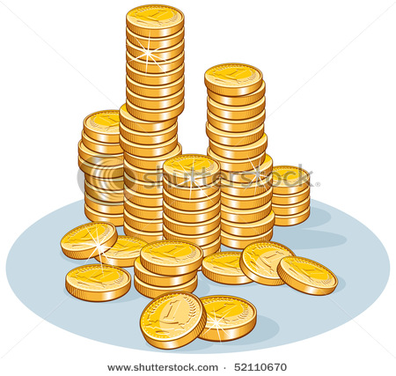
Session 1: Estimation
Time’s up!
Hold up your answer…
30
29
28
27
26
25
24
23
22
21
20
19
18
17
16
15
14
13
12
11
10
9
8
7
6
5
4
3
2
1

Slide 5
Session 1: Estimation
Answer: $203 to $224 (inclusive)

Slide 6

Session 1: Estimation
Question 2
Listen to the heartbeat. What is the pulse of the heartbeat in beats per minute?
(click here to play heartbeat sound)
Watches must be covered
Time’s up!
Hold up your answer…
13
9
12
11
15
8
1
14
10
4
6
2
3
7
5
After the heartbeat sound stops click again to start the timer. You have 15 seconds…...

Slide 7
Session 1: Estimation
Answer: 86±6 beats/mn

Slide 8
Session 1: Estimation
Question 3
You will be given a picture of a slice of pizza. Estimate what percentage of the whole pizza is shown on the picture?
Click to start the timer.
You have 30 seconds…
Time’s up!
Hold up your answer…
30
29
28
27
26
25
24
23
22
21
20
19
18
17
16
15
14
13
12
11
10
9
8
7
6
5
4
3
2
1

Slide 9
Session 1: Estimation
Answer: 8% to 12% (inclusive)

Slide 10
Session 1: Estimation
Question 4
Your team has been given a picture of some straws in a glass.
How many straws can you see in the picture (include any straws which are partly shown)?
Click to see the picture and start the timer.
You have 30 seconds…

Slide 11
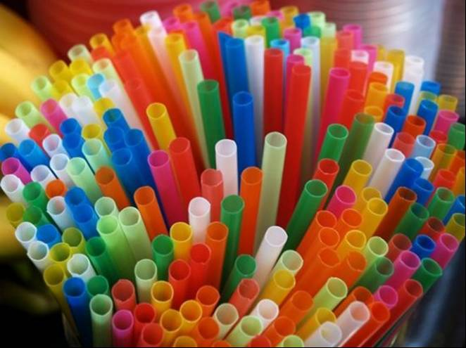
Time’s up!
Hold up your answer…
30
29
28
27
26
25
24
23
22
21
20
19
18
17
16
15
14
13
12
11
10
9
8
7
6
5
4
3
2
1

Slide 12
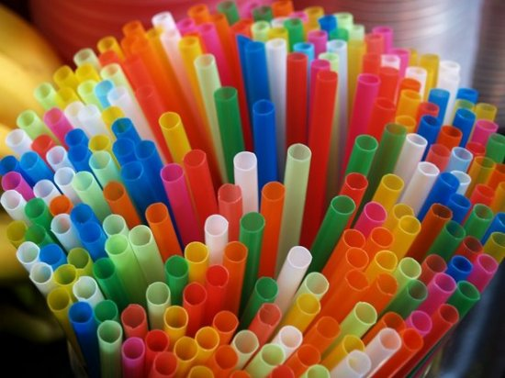
Answer: 190 – 234 (inclusive)
Suggestion: Locate the centre then estimate and count the straws in a quarter of the picture.
There are approx. 53 in a quarter.
Estimate total number of straws at 212

Slide 13
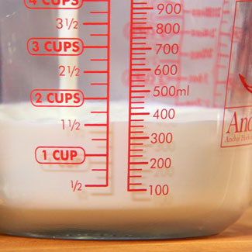
Session 1: Estimation
Question 5
You will be given a picture which shows a measuring jug containing a quantity of flour. Using the graduations on the jug estimate to the nearest ½ cup how many cups of milk would be the same as 1500mL?
Click to start the timer and to see the picture. You have 30 seconds…
Time’s up!
Hold up your answer…
30
29
28
27
26
25
24
23
22
21
20
19
18
17
16
15
14
13
12
11
10
9
8
7
6
5
4
3
2
1

Slide 14
Session 1: Estimation
Answer: 6 ½ Cups(accept only this answer)

Slide 15
That concludes
Session 1: Estimation

Slide 16
Session 2: Speed
Each team will be asked the same set of questions.
Teams will be asked to wait outside until it’s their turn.
There are a maximum of 12 questions to be answered orally by
each team within two minutes.
A team may ask for a question to be repeated, though they
should be aware that their time is limited.
A team may pass on any question and this question may be
repeated if time permits.
Calculators and writing paper/pens are NOT permitted.
The time starts after the first question has been read out.
If the team calls out more than one response, the team captain
must decide which one is the team answer.
All talking must cease when the gong sounds.
Units must be given when appropriate (half point penalty).

Slide 17
Session 2: Speed
Team 1:
***
Time’s up!
Click to start the timer.
You have 2 minutes…
1:30
1:29
1:28
1:27
1:26
1:25
1:24
1:23
1:22
1:21
1:20
1:19
1:18
1:17
1:16
1:15
1:14
1:13
1:11
1:10
1:09
1:12
1:08
1:07
1:06
1:05
1:04
1:03
1:02
1:01
2:00
1:59
1:58
1:57
1:56
1:55
1:54
1:53
1:52
1:51
1:50
1:49
1:48
1:47
1:46
1:45
1:43
1:41
1:44
1:40
1:39
1:38
1:37
1:36
1:35
1:34
1:42
1:33
1:32
1:31
1:00
59
58
57
56
55
54
53
52
51
50
49
48
47
46
45
44
43
42
41
39
38
37
35
36
34
33
32
40
31
30
29
28
27
26
25
24
23
22
21
20
19
18
17
16
15
14
13
12
11
10
9
8
7
6
5
4
3
2
1

Slide 18
Session 2: Speed
Team 2:
***
Time’s up!
Click to start the timer.
You have 2 minutes…
1:30
1:29
1:28
1:27
1:26
1:25
1:24
1:23
1:22
1:21
1:20
1:19
1:18
1:17
1:16
1:15
1:14
1:13
1:11
1:10
1:09
1:12
1:08
1:07
1:06
1:05
1:04
1:03
1:02
1:01
2:00
1:59
1:58
1:57
1:56
1:55
1:54
1:53
1:52
1:51
1:50
1:49
1:48
1:47
1:46
1:45
1:43
1:41
1:44
1:40
1:39
1:38
1:37
1:36
1:35
1:34
1:42
1:33
1:32
1:31
1:00
59
58
57
56
55
54
53
52
51
50
49
48
47
46
45
44
43
42
41
39
38
37
35
36
34
33
32
40
31
30
29
28
27
26
25
24
23
22
21
20
19
18
17
16
15
14
13
12
11
10
9
8
7
6
5
4
3
2
1

Slide 19
Session 2: Speed
Team 3:
***
Time’s up!
Click to start the timer.
You have 2 minutes…
1:30
1:29
1:28
1:27
1:26
1:25
1:24
1:23
1:22
1:21
1:20
1:19
1:18
1:17
1:16
1:15
1:14
1:13
1:11
1:10
1:09
1:12
1:08
1:07
1:06
1:05
1:04
1:03
1:02
1:01
2:00
1:59
1:58
1:57
1:56
1:55
1:54
1:53
1:52
1:51
1:50
1:49
1:48
1:47
1:46
1:45
1:43
1:41
1:44
1:40
1:39
1:38
1:37
1:36
1:35
1:34
1:42
1:33
1:32
1:31
1:00
59
58
57
56
55
54
53
52
51
50
49
48
47
46
45
44
43
42
41
39
38
37
35
36
34
33
32
40
31
30
29
28
27
26
25
24
23
22
21
20
19
18
17
16
15
14
13
12
11
10
9
8
7
6
5
4
3
2
1

Slide 20
Session 2: Speed
Team 4:
***
Time’s up!
Click to start the timer.
You have 2 minutes…
1:30
1:29
1:28
1:27
1:26
1:25
1:24
1:23
1:22
1:21
1:20
1:19
1:18
1:17
1:16
1:15
1:14
1:13
1:11
1:10
1:09
1:12
1:08
1:07
1:06
1:05
1:04
1:03
1:02
1:01
2:00
1:59
1:58
1:57
1:56
1:55
1:54
1:53
1:52
1:51
1:50
1:49
1:48
1:47
1:46
1:45
1:43
1:41
1:44
1:40
1:39
1:38
1:37
1:36
1:35
1:34
1:42
1:33
1:32
1:31
1:00
59
58
57
56
55
54
53
52
51
50
49
48
47
46
45
44
43
42
41
39
38
37
35
36
34
33
32
40
31
30
29
28
27
26
25
24
23
22
21
20
19
18
17
16
15
14
13
12
11
10
9
8
7
6
5
4
3
2
1

Slide 21
Session 2: Speed
Team 5:
***
Time’s up!
Click to start the timer.
You have 2 minutes…
1:30
1:29
1:28
1:27
1:26
1:25
1:24
1:23
1:22
1:21
1:20
1:19
1:18
1:17
1:16
1:15
1:14
1:13
1:11
1:10
1:09
1:12
1:08
1:07
1:06
1:05
1:04
1:03
1:02
1:01
2:00
1:59
1:58
1:57
1:56
1:55
1:54
1:53
1:52
1:51
1:50
1:49
1:48
1:47
1:46
1:45
1:43
1:41
1:44
1:40
1:39
1:38
1:37
1:36
1:35
1:34
1:42
1:33
1:32
1:31
1:00
59
58
57
56
55
54
53
52
51
50
49
48
47
46
45
44
43
42
41
39
38
37
35
36
34
33
32
40
31
30
29
28
27
26
25
24
23
22
21
20
19
18
17
16
15
14
13
12
11
10
9
8
7
6
5
4
3
2
1

Slide 22
Session 2: Speed
Team 6:
***
Time’s up!
Click to start the timer.
You have 2 minutes…
1:30
1:29
1:28
1:27
1:26
1:25
1:24
1:23
1:22
1:21
1:20
1:19
1:18
1:17
1:16
1:15
1:14
1:13
1:11
1:10
1:09
1:12
1:08
1:07
1:06
1:05
1:04
1:03
1:02
1:01
2:00
1:59
1:58
1:57
1:56
1:55
1:54
1:53
1:52
1:51
1:50
1:49
1:48
1:47
1:46
1:45
1:43
1:41
1:44
1:40
1:39
1:38
1:37
1:36
1:35
1:34
1:42
1:33
1:32
1:31
1:00
59
58
57
56
55
54
53
52
51
50
49
48
47
46
45
44
43
42
41
39
38
37
35
36
34
33
32
40
31
30
29
28
27
26
25
24
23
22
21
20
19
18
17
16
15
14
13
12
11
10
9
8
7
6
5
4
3
2
1

Slide 23
Session 2: Speed
Team 7:
***
Time’s up!
Click to start the timer.
You have 2 minutes…
1:30
1:29
1:28
1:27
1:26
1:25
1:24
1:23
1:22
1:21
1:20
1:19
1:18
1:17
1:16
1:15
1:14
1:13
1:11
1:10
1:09
1:12
1:08
1:07
1:06
1:05
1:04
1:03
1:02
1:01
2:00
1:59
1:58
1:57
1:56
1:55
1:54
1:53
1:52
1:51
1:50
1:49
1:48
1:47
1:46
1:45
1:43
1:41
1:44
1:40
1:39
1:38
1:37
1:36
1:35
1:34
1:42
1:33
1:32
1:31
1:00
59
58
57
56
55
54
53
52
51
50
49
48
47
46
45
44
43
42
41
39
38
37
35
36
34
33
32
40
31
30
29
28
27
26
25
24
23
22
21
20
19
18
17
16
15
14
13
12
11
10
9
8
7
6
5
4
3
2
1

Slide 24
Session 2: Speed
Team 8:
***
Time’s up!
Click to start the timer.
You have 2 minutes…
1:30
1:29
1:28
1:27
1:26
1:25
1:24
1:23
1:22
1:21
1:20
1:19
1:18
1:17
1:16
1:15
1:14
1:13
1:11
1:10
1:09
1:12
1:08
1:07
1:06
1:05
1:04
1:03
1:02
1:01
2:00
1:59
1:58
1:57
1:56
1:55
1:54
1:53
1:52
1:51
1:50
1:49
1:48
1:47
1:46
1:45
1:43
1:41
1:44
1:40
1:39
1:38
1:37
1:36
1:35
1:34
1:42
1:33
1:32
1:31
1:00
59
58
57
56
55
54
53
52
51
50
49
48
47
46
45
44
43
42
41
39
38
37
35
36
34
33
32
40
31
30
29
28
27
26
25
24
23
22
21
20
19
18
17
16
15
14
13
12
11
10
9
8
7
6
5
4
3
2
1

Slide 25
Session 2: Speed
Team 9:
***
Time’s up!
Click to start the timer.
You have 2 minutes…
1:30
1:29
1:28
1:27
1:26
1:25
1:24
1:23
1:22
1:21
1:20
1:19
1:18
1:17
1:16
1:15
1:14
1:13
1:11
1:10
1:09
1:12
1:08
1:07
1:06
1:05
1:04
1:03
1:02
1:01
2:00
1:59
1:58
1:57
1:56
1:55
1:54
1:53
1:52
1:51
1:50
1:49
1:48
1:47
1:46
1:45
1:43
1:41
1:44
1:40
1:39
1:38
1:37
1:36
1:35
1:34
1:42
1:33
1:32
1:31
1:00
59
58
57
56
55
54
53
52
51
50
49
48
47
46
45
44
43
42
41
39
38
37
35
36
34
33
32
40
31
30
29
28
27
26
25
24
23
22
21
20
19
18
17
16
15
14
13
12
11
10
9
8
7
6
5
4
3
2
1

Slide 26
Session 2: Speed
Team 10:
***
Time’s up!
Click to start the timer.
You have 2 minutes…
1:30
1:29
1:28
1:27
1:26
1:25
1:24
1:23
1:22
1:21
1:20
1:19
1:18
1:17
1:16
1:15
1:14
1:13
1:11
1:10
1:09
1:12
1:08
1:07
1:06
1:05
1:04
1:03
1:02
1:01
2:00
1:59
1:58
1:57
1:56
1:55
1:54
1:53
1:52
1:51
1:50
1:49
1:48
1:47
1:46
1:45
1:43
1:41
1:44
1:40
1:39
1:38
1:37
1:36
1:35
1:34
1:42
1:33
1:32
1:31
1:00
59
58
57
56
55
54
53
52
51
50
49
48
47
46
45
44
43
42
41
39
38
37
35
36
34
33
32
40
31
30
29
28
27
26
25
24
23
22
21
20
19
18
17
16
15
14
13
12
11
10
9
8
7
6
5
4
3
2
1

Slide 27
Answers:
 | Questions | Answer
1 | What is the sum of 87 and 54? | 141
2 | What is the size of the internal angle of a regular hexagon? | 120°
3 | How many millilitres are in 1.7 Litres | 1700mL
4 | What is the acute angle between the hour hand at 2 o’clock and the hour hand when it is at 4 o’clock? | 60°
5 | What is the square root of 0.04? | 0.2
6 | What is one third of one sixth? | 1/18
7 | Can 37 be written as the sum of two prime numbers? | No
8 | What is the sum of the numbers from 10 to 14 inclusive? | 60
9 | How much change will I get from $20 if I spend $8.40? | $11.60
10 | What is the area of a scalene triangle with a base of 6cm and a vertical height of 3cm? | 9cm²
11 | What is sum of 6.0 and -3.4? | 2.6
12 | What time is 2hours 45minutes before 12:15pm | 9:30am

Slide 28
That concludes
Session 2: Speed

Slide 29
Session 3: Written Problems
All contestants will be given the same 5 questions and
must work on them individually.
Only the answer in the space next to the original question is
accepted. Contestants are at liberty to use the working paper
given to them but the answers must be on the official sheet.
If more than one answer is given, or if the answer is
ambiguous, the answer will be marked incorrect
Calculators ARE permitted in this session.
Each question is worth one point so a team may achieve a
maximum of 15 points in this session.
There is a time limit of 15 minutes.
For the interest of the audience, the questions will be displayed
on the screen.
Click to see the questions and start the timer.

Slide 30
Session 3: Written Problems
Zac goes to RipOff Loans who lend him $4800 to buy his first car. On the last day of each month Zac repays $800. If Zac still owes money at the end of the month after his payment RipOff immediately adds $400 to the loan. How many months will Zac take to repay the loan?
20 students sit for a test and their average score is 12. If 5 more students did the test and their scores were 9,13,15,10 and 13, what is the average for all 25 students?
Pierre the pastry cook has lost his order book. All he can remember is that he needs to bake a combined total of 38 pies and cakes costing $144. If a pie costs $3.50 and a cake costs $4.00, how many of each are in the order?
B-Mart MostSports has a ‘40% of all marked prices’ sale. In the sale, a pair of basketball runners is sold for $84. Prior to the sale, the runners had already been marked down by 30%. What was the asking price of the runners before any markdowns had been applied?
Sarah’s spreadsheet shows that 3²³ is 94,143,178,827. However, when she tries to calculate 3³² her spreadsheet gives the result 1,853,020,188,851,840. She knows that can’t be right. What would be the last digit in this number (3³²) if it was worked out exactly?
Time’s up!
13 mins remaining
12 mins remaining
11 mins remaining
10 mins remaining
9 mins remaining
8 mins remaining
14 mins remaining
30
29
28
27
26
25
24
23
22
21
20
19
18
17
16
15
14
13
12
11
10
9
8
7
6
5
4
3
2
1
7 mins remaining
6 mins remaining
5 mins remaining
4 mins remaining
3 mins remaining
2 mins remaining
1 min remaining

Slide 31
Session 3: Written Problems
Answers:
Qn1: 11 months
Qn2: 12
Qn3: 22 cakes; 16 pies
Qn5: $200
Qn6: 1

Slide 32
That concludes
Session 3: Written Problems

Slide 33
Session 4: Individual Short Answer
Three questions will be asked, one at a time.
For each team, the team member on the compère's left will write
down the answer to the first question on the paper provided.
Assistance from other team members is not allowed.
Calculators ARE NOT permitted.
There will be a 20 second interval to write the
answer down and hold it up for the audience to see.
The compère will then indicate to the scorer which
teams have the correct answer.
Each question in this session is worth 2 points so each team
can score a maximum of 6 points in this session.
These steps will be repeated with the second question being
asked of the team member sitting in the middle, the third
question of the team member sitting on the compère's right.

Slide 34
Session 4:
Individual Short Answer
Click to see the first question
and then click again to start the timer.
You have 20 seconds…
Question 1
If a person walks for 2 hours at 4 km/hr and jogs for 45 minutes at 8 km/hr, how far does he travel in total?
Time’s up!
Hold up your answer…
20
19
18
17
16
15
14
13
12
11
10
9
8
7
6
5
4
3
2
1

Slide 35
Session 4: Individual Short Answer
Answer: 14km

Slide 36
Session 4:
Individual Short Answer
Click to see the second question
and then click again to start the timer.
You have 20 seconds…
Time’s up!
Hold up your answer…
Question 2
The 4th August 2010 was a Wednesday. On what day of the week will 4th August 2012 fall?
20
19
18
17
16
15
14
13
12
11
10
9
8
7
6
5
4
3
2
1

Slide 37
Session 4:
Individual Short Answer
Answer: Saturday

Slide 38
Session 4:
Individual Short Answer
Question 3
A tennis racquet is sold making a profit of $9.50. If the profit is 20% of the cost price, what did the racquet sell for?
Click to see the third question
and then click again to start the timer.
You have 20 seconds…
Time’s up!
Hold up your answer…
20
19
18
17
16
15
14
13
12
11
10
9
8
7
6
5
4
3
2
1

Slide 39
Session 4: Individual Short Answer
Answer: $57

Slide 40
That concludes
Session 4:
Individual Short Answer

Slide 41
Session 5: General Knowledge
There will be 5 questions, each worth one point.
  The compère will ask a question and there will be a 20 second interval during which a team may discuss the solution and write the answer on one of the sheets of paper provided.
  At the gong, each team must hold up its answer for the audience to see.
  The compère will then indicate to the scorer which schools have the correct answer.
Calculators are NOT permitted.
Incorrect spelling will be penalised ½ point

Slide 42
Session 5: General Knowledge
Question 1
In an early (Roman) form of the calendar the tenth month was known as ‘December’ (‘dec’ meaning 10th). In the same calendar what was the 8th month called?
Time’s up!
Hold up your answer…
Click to see the first question
and then click again to start the timer.
You have 20 seconds…
20
19
18
17
16
15
14
13
12
11
10
9
8
7
6
5
4
3
2
1

Slide 43
Session 5: General Knowledge
Answer:
October

Slide 44
Session 5: General Knowledge
Question 2
Which or the following is not an equivalent fraction to the other three?
Click to see the second question
and then click again to start the timer.
You have 20 seconds…
Time’s up!
Hold up your answer…
20
19
18
17
16
15
14
13
12
11
10
9
8
7
6
5
4
3
2
1

Slide 45
Session 5: General Knowledge
Answer:

Slide 46
Session 5: General Knowledge
Time’s up!
Hold up your answer…
Click to see the third question
and then click again to start the timer.
You have 20 seconds…
Question 3
How many lunar months are there in one calendar year?
20
19
18
17
16
15
14
13
12
11
10
9
8
7
6
5
4
3
2
1

Slide 47
Session 5: General Knowledge
Answer: 13
(a lunar month is 28 days)

Slide 48
Session 5: General Knowledge
Question 4
What is the name for the piece of a circle ‘cut off’ by a chord?
(Hint: also found in oranges)
Time’s up!
Hold up your answer…
Click to see the fourth question
and then click again to start the timer.
You have 20 seconds…
20
19
18
17
16
15
14
13
12
11
10
9
8
7
6
5
4
3
2
1

Slide 49
Session 5: General Knowledge
Answer: segment

Slide 50
Session 5: General Knowledge
Time’s up!
Hold up your answer…
Question 5
Sketch a triangle with side lengths 3, 4, and 5cm. The numbers 3, 4, and 5 are a ‘Pythagorean Triad’. Mark any special features of the triangle..
Click to see the fifth question
and then click again to start the timer.
You have 20 seconds…
20
19
18
17
16
15
14
13
12
11
10
9
8
7
6
5
4
3
2
1

Slide 51
Session 5: General Knowledge
Answer:
(or similar)

Slide 52
That concludes Session 5: General Knowledge
Please wait while the judges work out the final scores ....

Slide 53
TIE BREAKER (if needed)
Working as a team, consider the tiebreak question and write your answer on a piece of the paper provided.
Your team captain should take your answer to the judge’s table as fast as possible
In the event that your answer is incorrect return to your team table to consider another attempt. You will be disqualified if you do not go all the way back to your table
The first team to present the correct answer to the judge will be the winner.
Calculators are permitted.
Are there any questions about the rules? The Judge’s decision is final. Click to start .............

Slide 54
TIE BREAKER
The following sequence of numbers has a pattern. Find the pattern and use it to predict the 10th term.
Click to see the question and start the timer …….
Term | 1 | 2 | 3 | 4 | 5 | 6 | 7 | 8 | 9 | 10
Value | 0 | 2 | 6 | 12 | 20
Time’s up!
1:30
1:29
1:28
1:27
1:26
1:25
1:24
1:23
1:22
1:21
1:20
1:19
1:18
1:17
1:16
1:15
1:14
1:13
1:11
1:10
1:09
1:12
1:08
1:07
1:06
1:05
1:04
1:03
1:02
1:01
2:00
1:59
1:58
1:57
1:56
1:55
1:54
1:53
1:52
1:51
1:50
1:49
1:48
1:47
1:46
1:45
1:43
1:41
1:44
1:40
1:39
1:38
1:37
1:36
1:35
1:34
1:42
1:33
1:32
1:31
1:00
59
58
57
56
55
54
53
52
51
50
49
48
47
46
45
44
43
42
41
39
38
37
35
36
34
33
32
40
31
30
29
28
27
26
25
24
23
22
21
20
19
18
17
16
15
14
13
12
11
10
9
8
7
6
5
4
3
2
1

Slide 55
Answer: 90
(if there is no correct answer in the 2 minutes, the team with the answer closest to 90 which has already been taken to the judge’s table wins)

Slide 56
Yr 8 Quiz
Round 2

